Slide 1
Project 1
Observations on Facebook Live Sellers Dataset
Dushyant Pratap Singh
dushyant.singh@iitg.ac.in

Slide 2
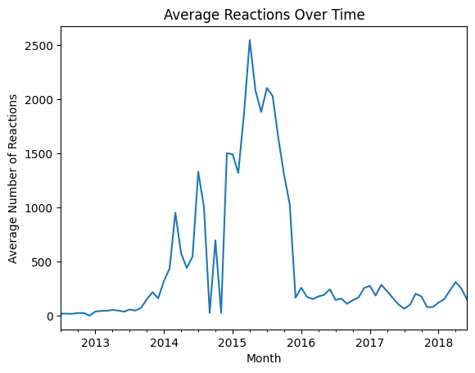
Average reactions over time
The graph shows a sharp peak around 2015, where the average number of reactions surpasses 2,500.
This marks the highest engagement period, possibly due to a viral event or significant change in Facebook features (e.g., launch of reaction buttons in early 2016).
From 2016 onward, the average number of reactions remains relatively low and stable, fluctuating modestly around 100–400.
This plateau suggests a return to baseline or audience saturation

Slide 3
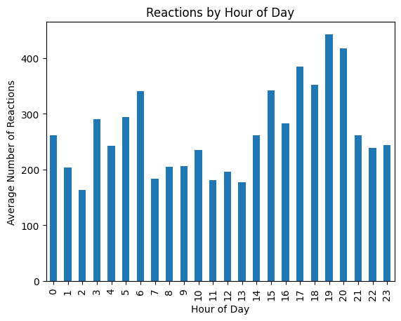
Average reactions by hour of day
The highest average number of reactions occurs at 18:00 (6 PM), closely followed by 19:00 (7 PM) and 20:00 (8 PM).
This suggests that early evening is the prime time for user engagement on Facebook — likely when people are relaxing after work or school.
There is a noticeable dip in reactions between 10 AM and 2 PM, with values dropping to their lowest around 13:00 (1 PM).
This may reflect reduced activity due to work commitments or lunchtime routines.

Slide 4
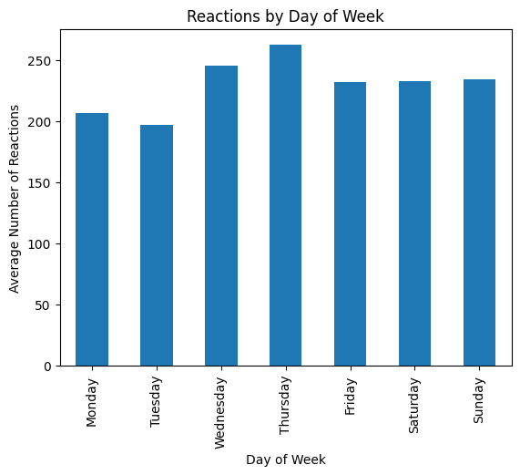
Average reactions by hour of day
Thursday stands out as the day with the highest average number of reactions, peaking above all other days.
This indicates that Thursday is the optimal day for posting content to maximize engagement.
Tuesday has the lowest average number of reactions, slightly below Monday.
This suggests Tuesday may be the least effective day for high interaction posts.
Saturday and Sunday show fairly consistent reaction levels, comparable to weekdays like Friday.
This implies that weekends are still good opportunities to reach active users.

Slide 5
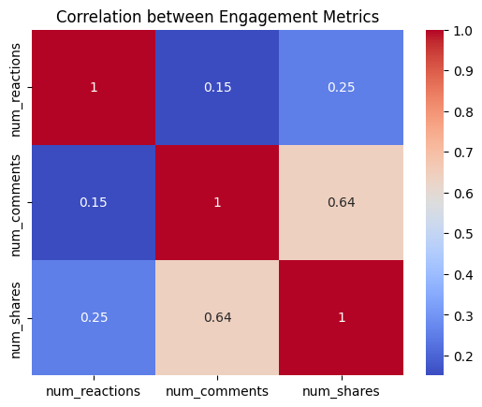
Correlation between number of Reactions and Engagement Metrics
The highest correlation is between num_comments and num_shares, with a value of 0.64, indicating a moderately strong positive relationship.
This suggests that posts generating more comments are also more likely to be shared, possibly due to content that sparks conversation and wider appeal.
num_reactions and num_comments have the lowest correlation (0.15) among the pairs.
This implies that a post with many reactions doesn't necessarily lead to more comments — i.e., liking something is passive, while commenting is more active.

Slide 6
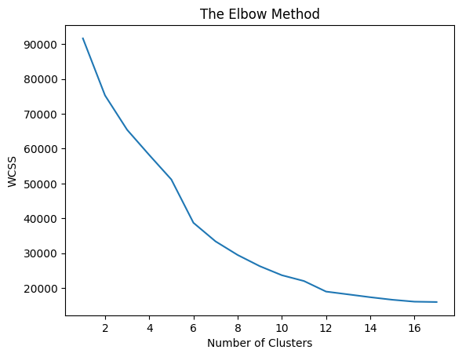
Elbow Method
The Within-Cluster Sum of Squares (WCSS) drops sharply up to 6 clusters, and then the curve starts to flatten.
This "elbow" suggests K = 6 is the optimal number of clusters.
Beyond K = 6, the WCSS still decreases but at a much slower rate
Indicates that the additional clusters might lead to overfitting or unnecessary complexity.
The WCSS becomes nearly flat from K = 13 onwards. (Plateau Effect Around K = 13–17)
Suggests very little improvement in compactness, and these extra clusters might not add meaningful structure.

Slide 7
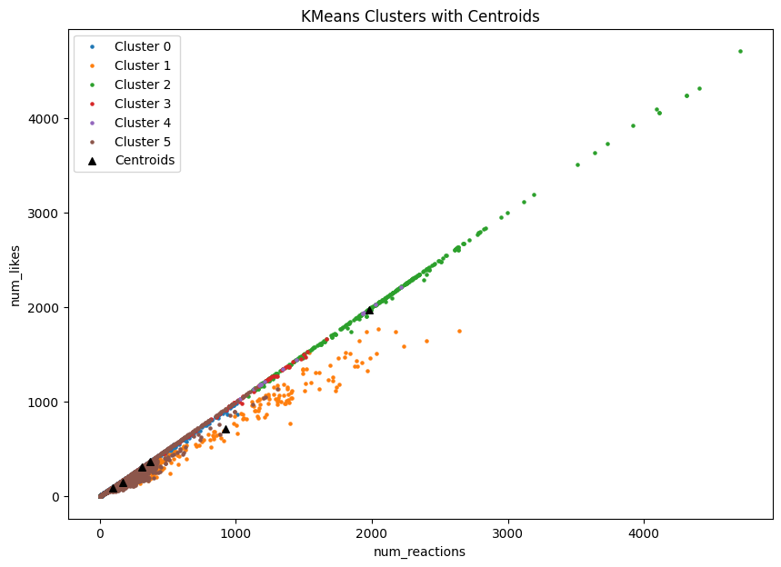

Slide 8
Observations from K-means clusters with centroids
Distinct Clusters Show Clear Separation
The plot reveals 6 well-separated clusters in terms of num_reactions and num_likes confirming that the elbow method’s K=6 choice is appropriate.
Each color represents a group of posts that behave similarly in terms of reactions and likes.
Strong Linear Relationship
Across all clusters, there is a near-perfect linear correlation between num_reactions and num_likes
This suggests that likes scale proportionally with total reactions—more engaging posts receive both higher likes and reactions.
Overlapping Near Origin (Low Engagement Posts)
Clusters 4 and 5 (likely darker shades) are concentrated near the origin.
These represent low-engagement posts with both low reactions and low likes.
Centroids for these clusters are close, indicating little variability among low-performing posts.

Slide 9
High-Performance Cluster (Likely Cluster 2 - Green)
The green cluster (Cluster 2) dominates the upper-right region, representing high-performing posts (thousands of reactions and likes).
The centroid for this group is significantly away from the origin, highlighting that this cluster contains outliers or viral content.
Centroid Placement Is Meaningful
The black triangles (centroids) lie approximately at the center of their respective clusters, validating the K-Means algorithm's effectiveness in minimizing intra-cluster variance.

Slide 10
Thank you

